Slide 1

GFS: The Google File System
Michael Siegenthaler
Cornell Computer Science
CS 6464
10th March 2009

Slide 2
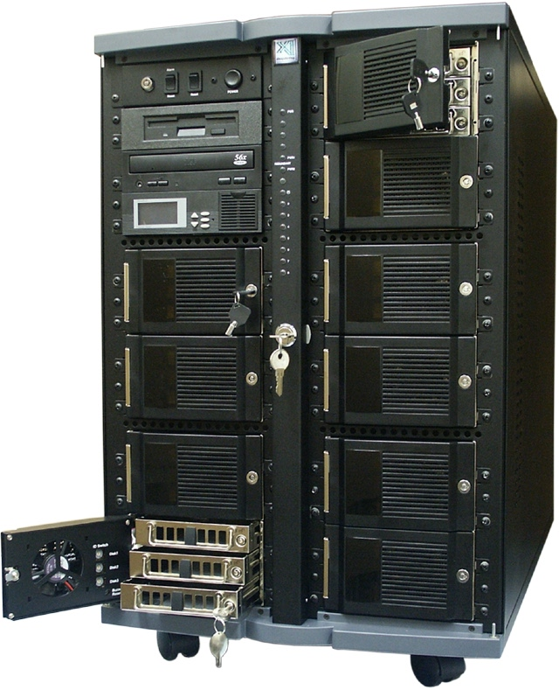
Motivating Application: Search
Crawl the whole web
Store it all on
“one big disk”
Process users’ searches on “one big CPU”
$$$$$
Doesn’t scale

Slide 3
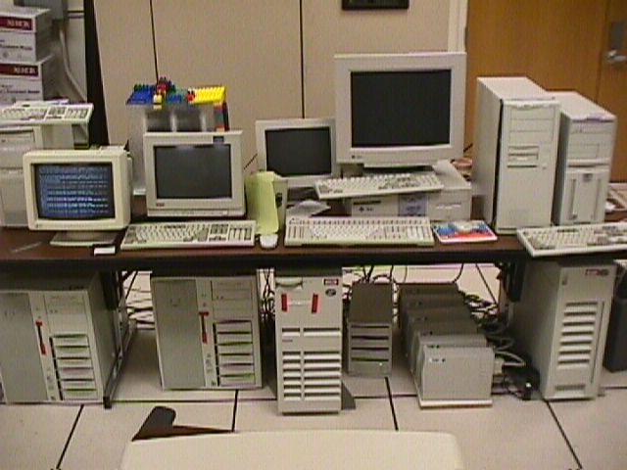

Slide 4
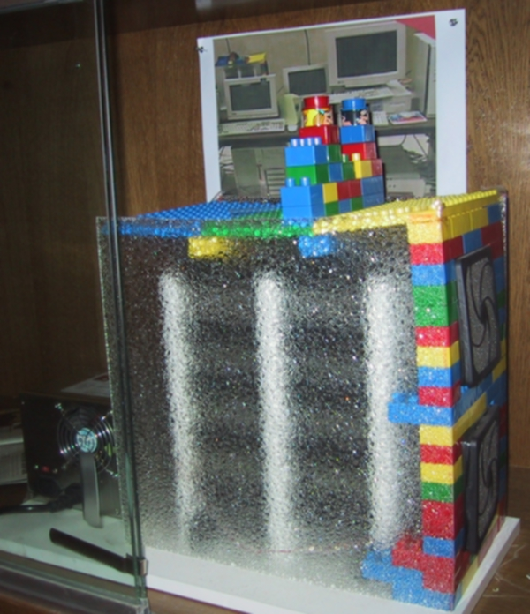

Slide 5
Google Platform Characteristics
Lots of cheap PCs, each with disk and CPU
  High aggregate storage capacity
  Spread search processing across many CPUs
How to share data among PCs?

Slide 6
Google Platform Characteristics
100s to 1000s of PCs in cluster
Many modes of failure for each PC:
  App bugs, OS bugs
  Human error
  Disk failure, memory failure, net failure, power supply failure
  Connector failure
Monitoring, fault tolerance, auto-recovery essential

Slide 7
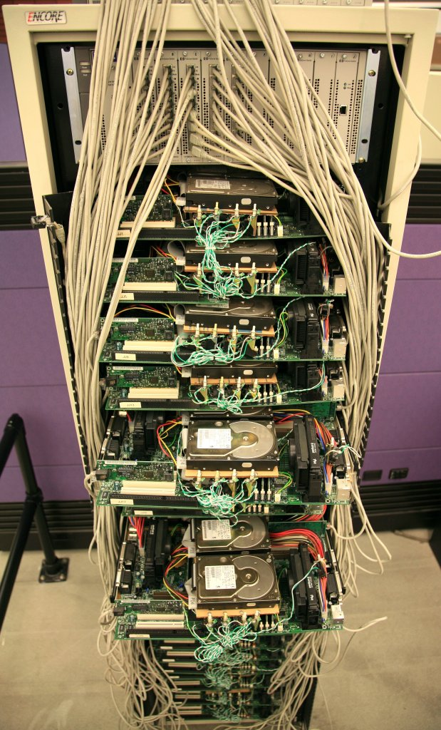
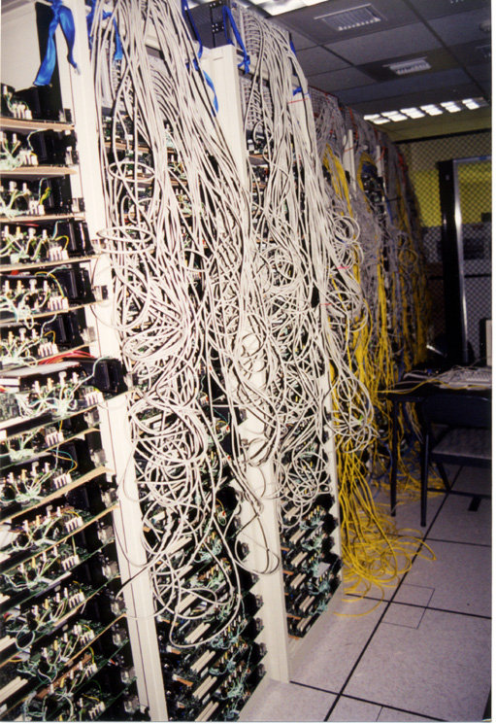

Slide 8
Google File System: Design Criteria
Detect, tolerate, recover from failures automatically
Large files, >= 100 MB in size
Large, streaming reads (>= 1 MB in size)
  Read once
Large, sequential writes that append
  Write once
Concurrent appends by multiple clients (e.g., producer-consumer queues)
  Want atomicity for appends without synchronization overhead among clients

Slide 9
GFS: Architecture
One master server (state replicated on backups)
Many chunk servers (100s – 1000s)
  Spread across racks; intra-rack b/w greater than inter-rack
  Chunk: 64 MB portion of file, identified by 64-bit, globally unique ID
Many clients accessing same and different files stored on same cluster

Slide 10
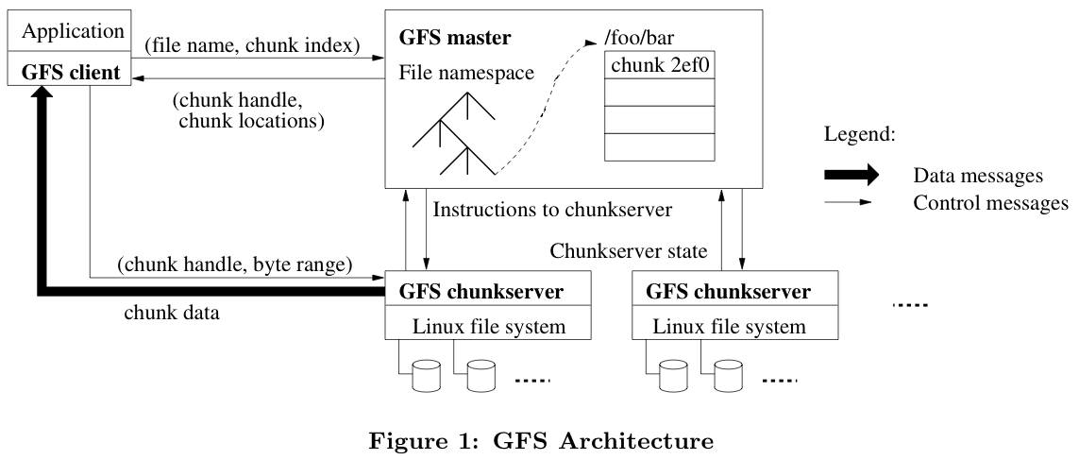
GFS: Architecture (2)

Slide 11
Master Server
Holds all metadata:
  Namespace (directory hierarchy)
  Access control information (per-file)
  Mapping from files to chunks
  Current locations of chunks (chunkservers)
Delegates consistency management
Garbage collects orphaned chunks
Migrates chunks between chunkservers
Holds all metadata in RAM; very fast operations on file system metadata

Slide 12
Chunkserver
Stores 64 MB file chunks on local disk using standard Linux filesystem, each with version number and checksum
Read/write requests specify chunk handle and byte range
Chunks replicated on configurable number of chunkservers (default: 3)
No caching of file data (beyond standard Linux buffer cache)

Slide 13
Client
Issues control (metadata) requests to master server
Issues data requests directly to chunkservers
Caches metadata
Does no caching of data
  No consistency difficulties among clients
  Streaming reads (read once) and append writes (write once) don’t benefit much from caching at client

Slide 14
Client API
Not a filesystem in traditional sense
  Not POSIX compliant
  Does not use kernel VFS interface
  Library that apps can link in for storage access
API:
  open, delete, read, write (as expected)
  snapshot: quickly create copy of file
  append: at least once, possibly with gaps and/or inconsistencies among clients

Slide 15
Client Read
Client sends master:
  read(file name, chunk index)
Master’s reply:
  chunk ID, chunk version number, locations of replicas
Client sends “closest” chunkserver w/replica:
  read(chunk ID, byte range)
  “Closest” determined by IP address on simple rack-based network topology
Chunkserver replies with data

Slide 16
Client Write
Some chunkserver is primary for each chunk
  Master grants lease to primary (typically for 60 sec.)
  Leases renewed using periodic heartbeat messages between master and chunkservers
Client asks master for primary and secondary replicas for each chunk
Client sends data to replicas in daisy chain
  Pipelined: each replica forwards as it receives
  Takes advantage of full-duplex Ethernet links

Slide 17
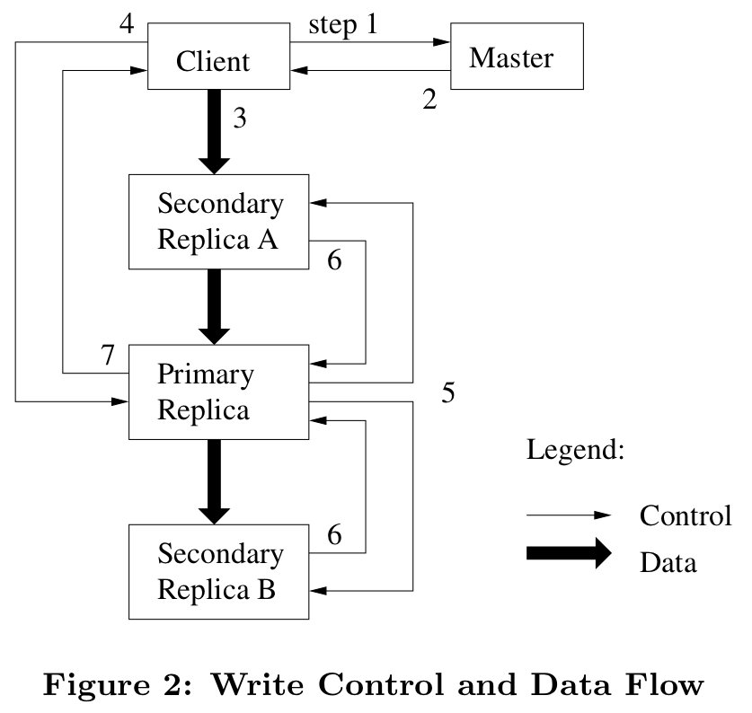
Client Write (2)

Slide 18
Client Write (3)
All replicas acknowledge data write to client
Client sends write request to primary
Primary assigns serial number to write request, providing ordering
Primary forwards write request with same serial number to secondaries
Secondaries all reply to primary after completing write
Primary replies to client

Slide 19
Client Record Append
Google uses large files as queues between multiple producers and consumers
Same control flow as for writes, except…
Client pushes data to replicas of last chunk of file
Client sends request to primary
Common case: request fits in current last chunk:
  Primary appends data to own replica
  Primary tells secondaries to do same at same byte offset in theirs
  Primary replies with success to client

Slide 20
Client Record Append (2)
When data won’t fit in last chunk:
  Primary fills current chunk with padding
  Primary instructs other replicas to do same
  Primary replies to client, “retry on next chunk”
If record append fails at any replica, client retries operation
  So replicas of same chunk may contain different data—even duplicates of all or part of record data
What guarantee does GFS provide on success?
  Data written at least once in atomic unit

Slide 21
GFS: Consistency Model
Changes to namespace (i.e., metadata) are atomic
  Done by single master server!
  Master uses log to define global total order of namespace-changing operations

Slide 22
GFS: Consistency Model (2)
Changes to data are ordered as chosen by a primary
  All replicas will be consistent
  But multiple writes from the same client may be interleaved or overwritten by concurrent operations from other clients
Record append completes at least once, at offset of GFS’s choosing
  Applications must cope with possible duplicates

Slide 23
GFS: Data Mutation Consistency
 | Write | Record Append
serial success | defined | defined interspersed with inconsistent
concurrent success | consistent but undefined
failure | inconsistent

Slide 24
Applications and
Record Append Semantics
Applications should use self-describing records and checksums when using Record Append
  Reader can identify padding / record fragments
If application cannot tolerate duplicated records, should include unique ID in record
  Reader can use unique IDs to filter duplicates

Slide 25
Logging at Master
Master has all metadata information
  Lose it, and you’ve lost the filesystem!
Master logs all client requests to disk sequentially
Replicates log entries to remote backup servers
Only replies to client after log entries safe on disk on self and backups!

Slide 26
Chunk Leases and Version Numbers
If no outstanding lease when client requests write, master grants new one
Chunks have version numbers
  Stored on disk at master and chunkservers
  Each time master grants new lease, increments version, informs all replicas
Master can revoke leases
  e.g., when client requests rename or snapshot of file

Slide 27
What If the Master Reboots?
Replays log from disk
  Recovers namespace (directory) information
  Recovers file-to-chunk-ID mapping
Asks chunkservers which chunks they hold
  Recovers chunk-ID-to-chunkserver mapping
If chunk server has older chunk, it’s stale
  Chunk server down at lease renewal
If chunk server has newer chunk, adopt its version number
  Master may have failed while granting lease

Slide 28
What if Chunkserver Fails?
Master notices missing heartbeats
Master decrements count of replicas for all chunks on dead chunkserver
Master re-replicates chunks missing replicas in background
  Highest priority for chunks missing greatest number of replicas

Slide 29
File Deletion
When client deletes file:
  Master records deletion in its log
  File renamed to hidden name including deletion timestamp
Master scans file namespace in background:
  Removes files with such names if deleted for longer than 3 days (configurable)
  In-memory metadata erased
Master scans chunk namespace in background:
  Removes unreferenced chunks from chunkservers

Slide 30
Limitations
Security?
  Trusted environment, trusted users
  But that doesn’t stop users from interfering with each other…
Does not mask all forms of data corruption
  Requires application-level checksum

Slide 31
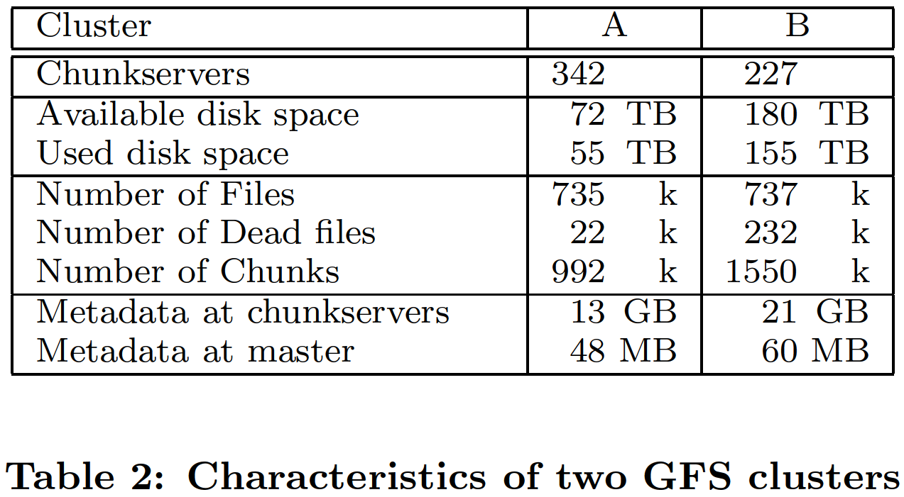

Slide 32
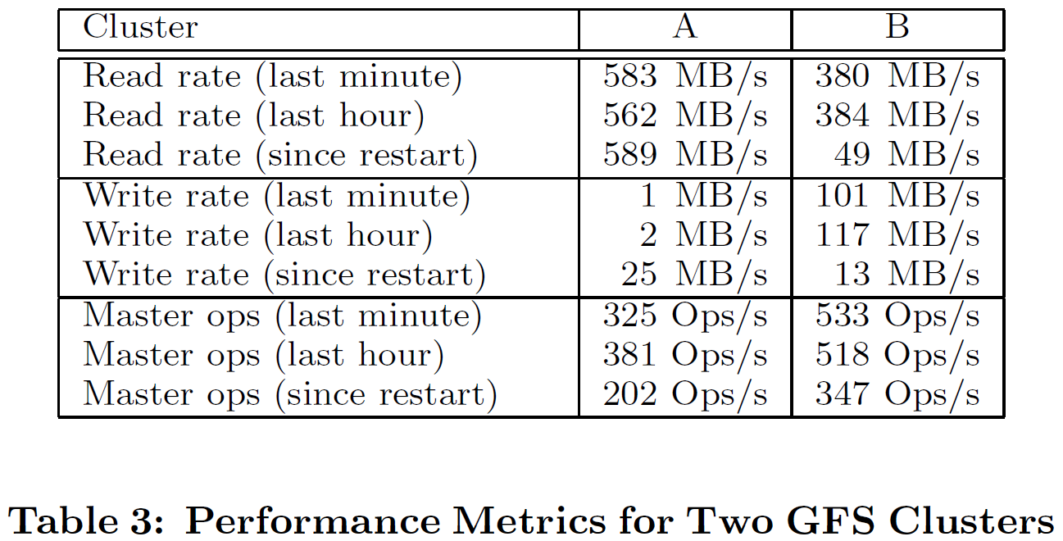

Slide 33
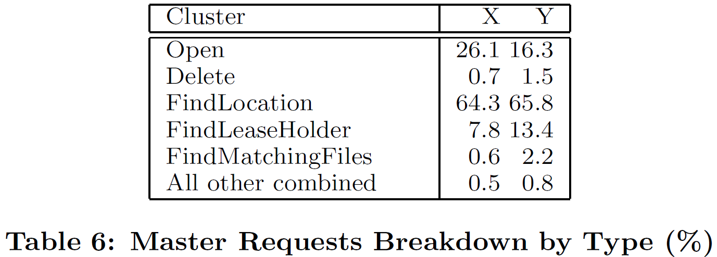

Slide 34
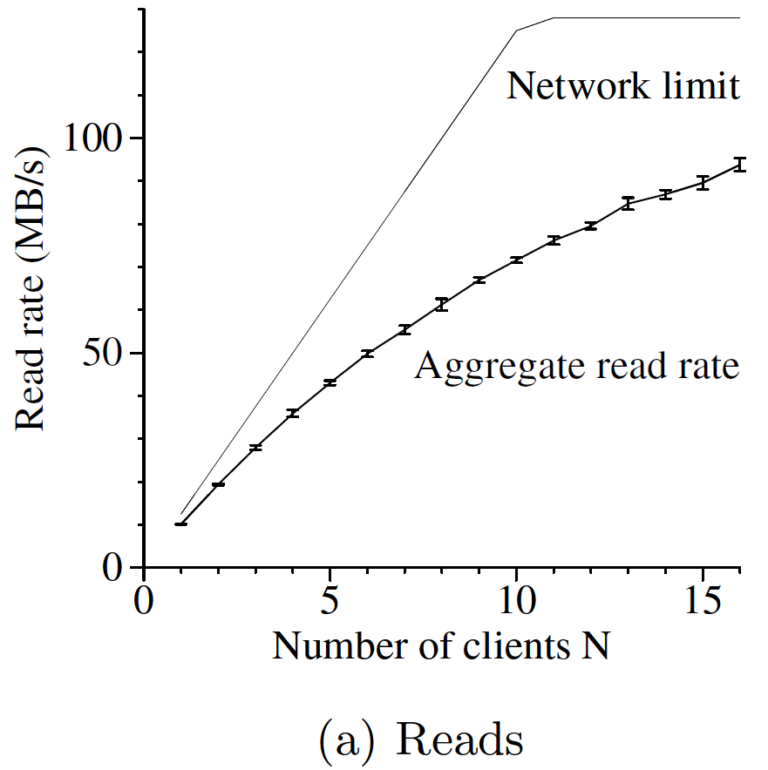

Slide 35
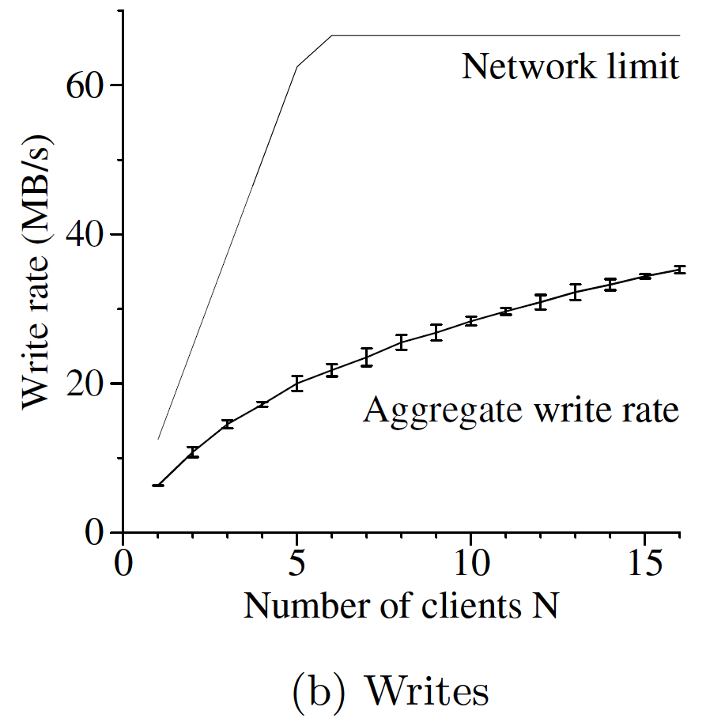

Slide 36
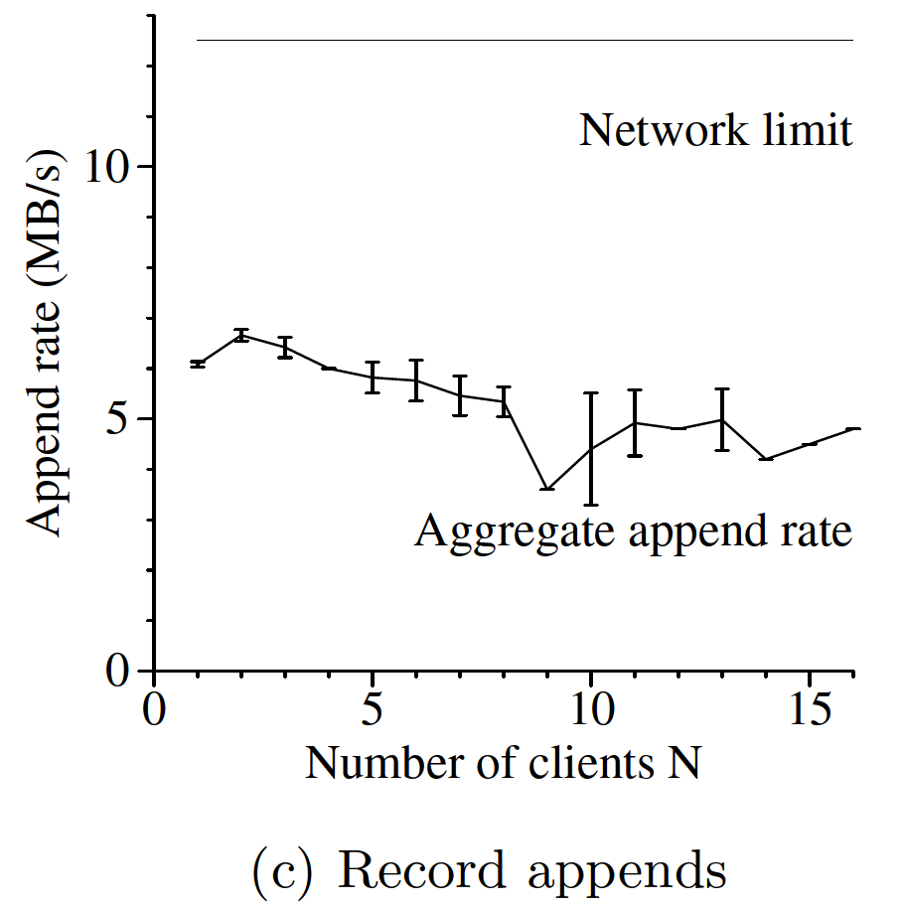
(for a single file)

Slide 37
Recovery Time
Experiment: killed 1 chunkserver
  Clonings limited to 40% of the chunkservers and 50 Mbps each to limit impact on applications
  All chunks restored in 23.2 min
Experiment: killed 2 chunkservers
  266 of 16,000 chunks reduced to single replica
  Higher priority re-replication for these chunks
  Achieved 2x replication within 2 min

Slide 38
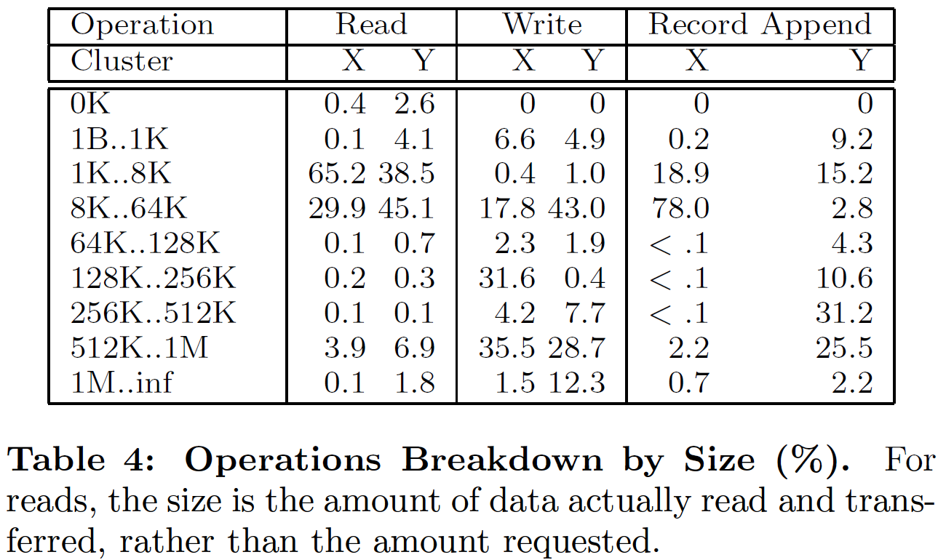

Slide 39
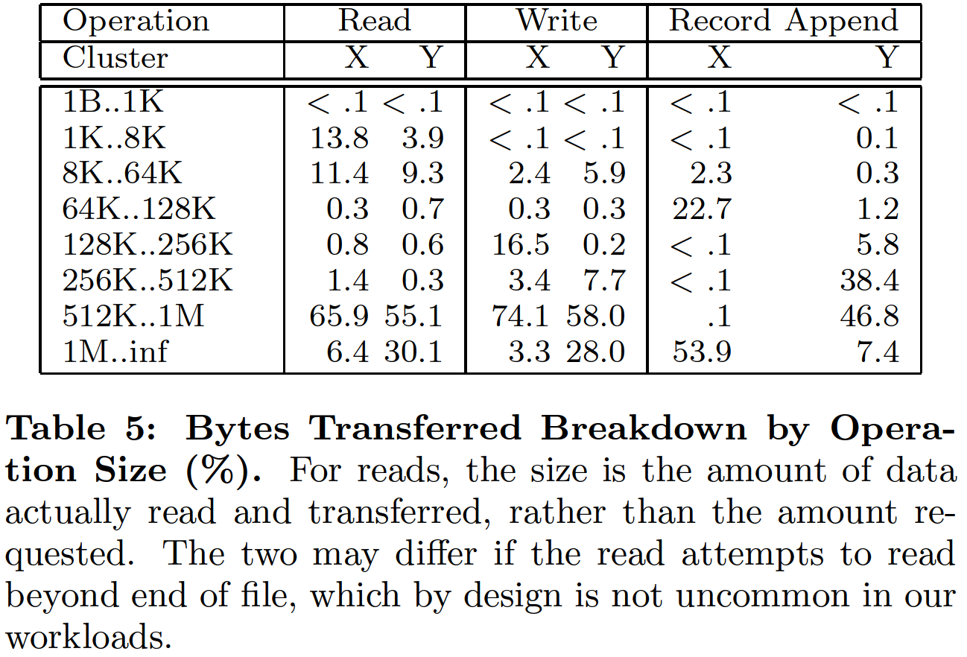

Slide 40
GFS: Summary
Success: used actively by Google to support search service and other applications
  Availability and recoverability on cheap hardware
  High throughput by decoupling control and data
  Supports massive data sets and concurrent appends
Semantics not transparent to apps
  Must verify file contents to avoid inconsistent regions, repeated appends (at-least-once semantics)
Performance not good for all apps
  Assumes read-once, write-once workload (no client caching!)

